Slide 1
DATA QUALITY
ISSUES
Data quality and errors – Sources of error in GIS – Finding and modeling errors of GIS – Managing GIS error

Slide 2
INTRODUCTION
Quality is a word in everyday use that is very difficult to define.
It has different meanings for different people and in different contexts.
A dictionary definition of quality is ‘degree of excellence’ (Collins, 1981).
In GIS, data quality is used to give an indication of how good data are. It describes the overall fitness or suitability of data for a specific purpose or is used to indicate data free from errors and other problems.

Slide 3
INTRODUCTION
In many industries, whether they are in the manufacturing or service sectors, quality control is everything.
Without a quality product that is properly designed, well made and reliable, customers will go elsewhere for the goods and services they require.
GIS users strive for quality products from their systems, and hope to produce good quality results and output.
Whether users are in local government, business, research or any other sector, quality is an issue.

Slide 4
INTRODUCTION
But mistakes and errors can enter a GIS in many different ways, leading to difficulties for many different users.
For example a mistake in digitizing a field boundary may result in inaccurate calculation of potential crop yields.
A mistake in the transcription of a grid reference could result in emergency personnel being sent to the wrong incident location.
Misinterpretation of satellite imagery may lead to inaccurate flood plain definition and in turn inappropriate planning decisions.

Slide 5
INTRODUCTION
And ill-considered selection of interpolation operations may lead to the incorrect calculation of wind turbine visibility.
Errors may come from source data, human error, incorrect selection of analysis operations, and inappropriate presentation of final results.
The computing saying ‘garbage in, garbage out’ recognizes that if you put poor quality data into your program, you will output poor quality results.
The saying applies to GIS since the results of analysis are only as good as the data put into the GIS in the first place.

Slide 6
INTRODUCTION
Previous chapters have shown how easy it is to combine maps, create buffer zones, interpolate point data sets and perform dozens of other operations with a GIS to produce complex and attractive maps.
However, errors in input data may be compounded during these analyses, and errors in classification or interpretation may create misleading final output for end-users.

Slide 7
INTRODUCTION
Maps produced by a computer have an inherent feeling of quality and authority. Naive users have a tendency to believe what they see on the screen, and complexity, clever colours and intrinsic visual appeal may fool users into thinking that GIS output is of a high quality.
But what is a high-quality product? What exactly are good quality data? How can we describe and recognize poor quality output?

Slide 8
INTRODUCTION
Two issues are particularly important in addressing quality and error issues:
First, the terminology used for describing problems, and
Second, the sources, propagation and management of errors.
Describing data problems in GIS is difficult since many of the words used are also common in everyday language.
Words such as quality, accuracy and error not only mean different things to different people but also have precise technical definitions.

Slide 9
INTRODUCTION
The terms used for data error and quality are introduced at the start of this chapter, since the first step to solving problems is to be able to recognize and describe them.
The remainder of the chapter outlines the types and sources of errors in GIS to help you recognize and deal with problems at the appropriate stage of a GIS project.

Slide 10
INTRODUCTION
Techniques for modelling and managing errors are also considered.
These techniques are important, as few data sets are error-free.
GIS users must learn to manage and live with the errors their data and systems produce.
Perhaps more importantly, GIS users should document the limitations of their source data and the output generated.
Such documentation will ensure that output will be of value to others and will permit appropriate future use of data.

Slide 11
INTRODUCTION
Returning to our motorcar analogy, you might be less likely to buy an old vehicle from a car auction (which might have high mileage, several owners and no service history) than a smart little car with quality assurance documentation from an established dealership (with guaranteed low mileage, one careful owner and a full service history).
The same principles apply to GIS data. Quality control should be impeccable because confidence in GIS analysis and results relies heavily on having access to reliable, good quality data.

Slide 12
INTRODUCTION
Earlier in the book we compared the fuel in a car to data in a GIS.
In the same way that a poor quality fuel may cause problems with the running of the car, poor quality data will introduce errors into your GIS.

Slide 13
DESCRIBING DATA QUALITY AND
ERRORS
GIS users must describe data problems before they can solve them.
So, before discussing the sources of data problems and their implications and management, this chapter considers the terms used to describe data problems in a GIS context.
These terms will be used later in discussions of the sources of error in GIS.

Slide 14
DESCRIBING DATA QUALITY AND
ERRORS
Quality is a word in everyday use that is very difficult to define. It has different meanings for different people and in different contexts.
A dictionary definition of quality is ‘degree of excellence’ (Collins, 1981).
In GIS, data quality is used to give an indication of how good data are.
It describes the overall fitness or suitability of data for a specific purpose or is used to indicate data free from errors and other problems.

Slide 15
DESCRIBING DATA QUALITY AND
ERRORS
Examining issues such as error, accuracy, precision and bias can help to assess the quality of individual data sets.
In addition, the resolution and generalization of source data, and the data model used, may influence the portrayal of features of interest.
Data sets used for analysis need to be complete, compatible and consistent, and applicable for the analysis being performed.

Slide 16
DESCRIBING DATA QUALITY AND
ERRORS
These concepts are:
Flaws in data are usually referred to as errors.
Error is the physical difference between the real world and the GIS facsimile.
Errors may be single, definable departures from reality, or may be persistent, widespread deviations throughout a whole database.

Slide 17
DESCRIBING DATA QUALITY AND
ERRORS
In the Happy Valley database a single error in a point data set would occur if a co-ordinate pair representing a ski lift station were entered incorrectly, perhaps with two digits in the wrong order.
A more systematic error would have occurred if the co-ordinates for all the ski lift stations in the data set had been entered in (y,x) order instead of (x,y).

Slide 18
DESCRIBING DATA QUALITY AND
ERRORS
Accuracy is the extent to which an estimated data value approaches its true value (Aronoff, 1989). If a GIS database is accurate, it is a true representation of reality.
It is impossible for a GIS database to be 100 per cent accurate, though it is possible to have data that are accurate to within specified tolerances.
For example, a ski lift station co-ordinate may be accurate to within plus or minus 10 metres.

Slide 19
DESCRIBING DATA QUALITY AND
ERRORS
Precision is the recorded level of detail of your data. A co-ordinate in metres to the nearest 12 decimal places is more precise than one specified to the nearest three decimal places.
Computers store data with a high level of precision, though a high level of precision does not imply a high level of accuracy.

Slide 20
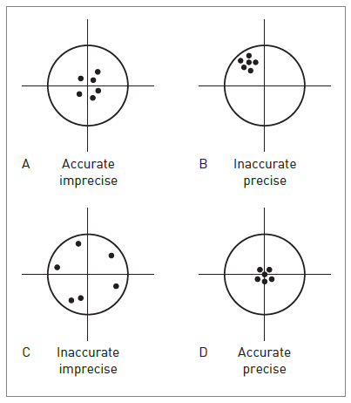
The difference between accuracy and precision is Shown:

Slide 21
The difference between accuracy and precision is Shown:
It is perfectly feasible to have a GIS data set that is highly accurate but not very precise, and vice versa.
Contestant A was accurate but not precise; contestant B was inaccurate but precise; contestant C was neither accurate nor precise; and contestant D, the winner, was both accurate and precise.
Extending this illustration to GIS, imagine the target is geographical space. The ‘bull’s eye’, or central cross on the target, is the true geographical location of a feature we are trying to locate and the athletes’ ‘hits’ on the target represent points collected by surveying or positioning techniques.

Slide 22
DESCRIBING DATA QUALITY AND
ERRORS
Bias in GIS data is the systematic variation of data from reality. Bias is a consistent error throughout a data set.
A consistent overshoot in digitized data caused by a badly calibrated digitizer, or the consistent truncation of the decimal points from data values by a software program, are possible examples.
These examples have a technical source. Human sources of bias also exist. An aerial photograph interpreter may have a consistent tendency to ignore all features below a certain size. Although such consistent errors should be easy to rectify, they are often very difficult to spot.

Slide 23
DESCRIBING DATA QUALITY AND
ERRORS
For example, for a raster data set with a 20- metre cell size, only those features that are 20 × 20 metres or larger can be distinguished.
At this resolution it is possible to map large features such as fields, lakes and urban areas but not individual trees or telegraph poles because they measure less than 20 × 20 metres.
Figure allows comparison of a 25 metre resolution vegetation map with a 5 metre resolution aerial photograph of the same area.

Slide 24
DESCRIBING DATA QUALITY AND
ERRORS
Notice how the vegetation map only picks out the main pattern in vegetation, and generalizes the detailed mosaic of different vegetation types on the aerial photograph.
Vector data can also have resolution, although this is described in different terms.
Resolution is dependent on the scale of the original map, the point size and line width of the features represented thereon and the precision of digitizing.

Slide 25
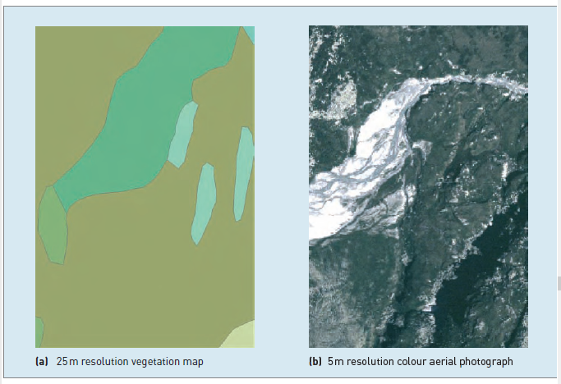
Resolution and generalization of raster datasets

Slide 26
DESCRIBING DATA QUALITY AND
ERRORS
Generalization is the process of simplifying the complexities of the real world to produce scale models and maps.
Cartographic generalization is a subject in itself and is the cause of many errors in GIS data derived from maps.
It is the subjective process by which the cartographer selectively removes the enormous detail of the real world in order to make it understandable and attractive in map form.

Slide 27
DESCRIBING DATA QUALITY AND
ERRORS
There are further data quality considerations if data sets are to be used in a GIS. Completeness, compatibility, consistency and applicability are introduced here.
A complete data set will cover the study area and the time period of interest in its entirety.
The data are complete spatially and temporally, and should have a complete set of attribute information.
Completeness of polygon data is relatively easy to determine.

Slide 28
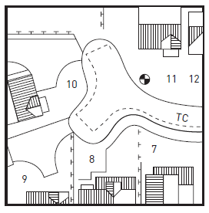
Scale-related generalization
1:10,000

Slide 29
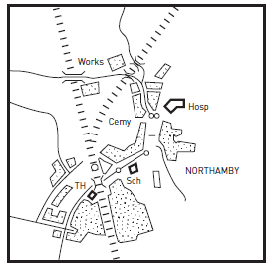
Scale-related generalization
1:50,000

Slide 30
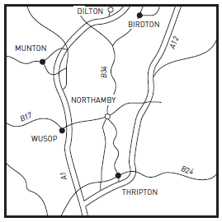
Scale-related generalization
1:500,000

Slide 31
DESCRIBING DATA QUALITY AND
ERRORS
Errors in attribute data might be seen as polygons lacking attribute information, and errors in spatial data may be seen as polygons with two sets of attribute data.
Completeness of line and point data is less obvious as features may be missing without showing up in the database.
The only way to check is by comparison with another source.
Sample data, whether taken via a random, regular or systematic survey, are by definition incomplete.

Slide 32
DESCRIBING DATA QUALITY AND
ERRORS
In this instance, completeness is a matter of having a sufficiently large sample size to represent adequately the variation in the real world.
In the case of time series data, completeness is very difficult to define, let alone assess.
Almost all time series data in GIS are referenced to discrete moments in time.
However, time is continuous. A set of maps relating to a series of discrete times is therefore incomplete, and requires broad assumptions to be made regarding change in the intervening periods.

Slide 33
DESCRIBING DATA QUALITY AND
ERRORS
Compatible data sets can be used together sensibly. With GIS it is possible to overlay two maps, one originally mapped at a scale of 1:500,000 and the other at 1:25,000.
The result, however, is largely worthless because of incompatibility between the scales of the source documents.
Maps containing data measured in different scales of measurement cannot be combined easily.
Overlaying a map of snow depths in Happy Valley (in metres – ratio scale) with a map of piste and non-piste areas (binary classification – nominal scale) using a union operation would produce a meaningless output map.

Slide 34
DESCRIBING DATA QUALITY AND
ERRORS
To ensure compatibility, ideally data sets should be developed using similar methods of data capture, storage, manipulation and editing.
Consistency applies not only to separate data sets but also within individual data sets.
Inconsistencies can occur within data sets where sections have come from different source documents or have been digitized by different people.
This will cause spatial variation in the error characteristics of the final data layer. One area of the final data set may contain more errors than another.

Slide 35
DESCRIBING DATA QUALITY AND
ERRORS
Problems of inconsistency also come from the manner in which the data were collected.
For example, in Happy Valley there are meteorological stations that record snowfall.
The equipment used to measure snowfall is of different ages and designs and thus the accuracy of the measurements obtained varies from station to station.
If meteorological stations are included in a GIS as points, with snowfall records as their attributes, inconsistencies will be introduced to the database.

Slide 36
DESCRIBING DATA QUALITY AND
ERRORS
Another example is administrative boundaries. These are subject to constant revision as a result of international disputes and internal reorganization, thus positional inconsistencies may occur where boundary revisions have taken place.
Applicability is a term used to describe the appropriateness or suitability of data for a set of commands, operations or analyses.
For example, interpolating height data using Thiessen polygons may be an unsuitable match between data and technique, as height data vary continuously (not abruptly as assumed by the Thiessen polygon method).

Slide 37
DESCRIBING DATA QUALITY AND
ERRORS
Alternatively, applicability can be used to describe the suitability of data to solve a particular problem.
It is inappropriate to use height data to estimate some socio-economic variables, such as car ownership, but height data may be applicable to estimating the number of days in a year with snow cover.
The criteria introduced above provide some pointers for gauging the overall quality of GIS databases.

Slide 38
DESCRIBING DATA QUALITY AND
ERRORS
However, in the same way that different terms can be interpreted in different ways, the quality criteria regarded as important by data creators and users are likely to be different.
Suppliers of digital topographic maps to the Happy Valley GIS team may regard their data as of high quality if they are complete and up to date at a range of scales, and if they deliver a known and measurable degree of accuracy.
Their reputation depends on their ability to supply a product of consistent standard.

Slide 39
DESCRIBING DATA QUALITY AND
ERRORS
However, different criteria may be important for the data users. The GIS team may require precise data on particular themes, and data that are compatible with their GIS system.
They want all slopes and cliffs to be represented consistently. They may be unwilling to use the data for decision support if they know it contains errors.

Slide 40
SOURCES OF ERROR IN GIS
Having the terminology to describe flaws in data is a good first step to providing quality GIS.
Awareness of the sources of problems comes next. Spatial and attribute errors can occur at any stage in a GIS project.
They may arise during the definition of spatial entities, from the representation of these entities in the computer, or from the use of data in analysis.
In addition, they may be present in source data, arise during conversion of data to digital format, occur during data manipulations and processing, or even be produced during the presentation of results.
The best way to explore how and where errors may arise is to view them within the context of a typical GIS project.

Slide 41
Errors arising from our understanding and modelling of reality
Some of the errors arising in GIS have a source far away from the computer.
Errors can originate from the ways in which we perceive, study and model reality.
These errors can be termed conceptual errors, since they are associated with the representation of the real world for study and communication.
The different ways in which people perceive reality can have effects on how they model the world using GIS.
Mental mapping provides an illustration of how varying perceptions can manifest themselves in a geographical context.

Slide 42
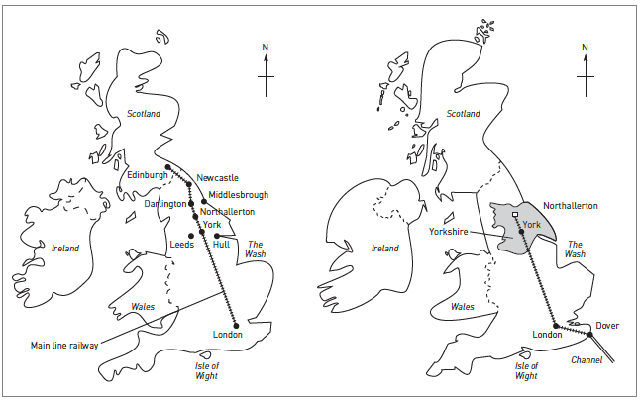
MENTAL MAPS

Slide 43
Mental Maps
Your mental map of your home town or local area is your personal, internalized representation that you use to help you navigate on a day-to-day basis and describe locations to other people.
You could commit this to paper as a sketch map if required.
This presents two sketch maps describing the location of Northallerton in the UK.
They would be flawed as cartographic products, but nevertheless are a valid model of reality.

Slide 44
Mental Maps
Keates (1982) considers these maps to be personal, fragmentary, incomplete and frequently erroneous.
Consider the mental maps that a group of residents and visitors in Happy Valley might draw.
The residents might stress their homes, place of work and community facilities.
Visitors would include their hotel, ski school, ski runs and the après-ski facilities.
In all cases, distance and shape would be distorted in inconsistent ways and the final product would be influenced by the personality and experience of the ‘cartographer’.

Slide 45
Errors arising from our understanding and modelling of reality
Our perception of reality influences our definition of reality, and in turn our use of spatial data.
This can create real errors and often gives rise to inconsistencies between data collected by different surveyors, maps drawn by different cartographers and databases created by different GIS users.
Different scientific disciplines have developed their own particular ways of explaining and studying reality.
Compare the reductionist approach of the physical sciences, such as physics and chemistry, with the wider, more holistic approaches of the environmental sciences such as geography and ecology.

Slide 46
Errors arising from our understanding and modelling of reality
The reductionist view attempts to explain and model parts of the world system by isolating individual physical, chemical and biological processes at a micro scale, whereas the holistic view attempts an explanation on the basis of related and interdependent macro- and meso-scale systems.
For example, a biologist is more likely to be interested in photosynthesis as a biochemical process, taking place at the level of an individual plant cell or leaf.
An ecologist is no less interested in the process of photosynthesis but takes a much wider view of its role.

Slide 47
Errors arising from our understanding and modelling of reality
Given such different approaches to science it is understandable that difficulties (such as bias and compatibility) arise when different people’s models of space and process are compared.
In GIS we use spatial models to reflect reality. The main models in use are raster, vector, object-oriented
and layer-based.
All of these spatial models have limitations when it comes to portraying reality.
For instance, the raster model assumes that all real-world features can be represented as individual cells or collections of cells. This is clearly not the case.

Slide 48
Errors arising from our understanding and modelling of reality
The vector model assumes that all features can be given a single co-ordinate or a collection of Cartesian co-ordinates.
The world is actually made up of physical and biological material, which is, in turn, made up of molecular and sub-molecularmatter grouped into complex systems linked by flows of energy and materials (solids, liquids and gases).

Slide 49
Errors arising from our understanding and modelling of reality
Consider the problem of defining a common geographical feature such as a mountain in a GIS.
First we need to define exactly what we mean by ‘mountain’. This in itself becomes problematic since different people have different ideas as to what a mountain exactly is, where it begins, where it ends and how it is linked to other morphological features such as valleys and passes.
Does Mount Everest begin at sea level in the Bay of Bengal to the south, or does it rise out of the Tibetan Plateau to the north?

Slide 50
Errors arising from our understanding and modelling of reality
From a mountaineer’s perspective, the base of the mountain may be base camp below the Khumbu icefall – the place from which most climbing expeditions start.
Everest base camp lies at 5500 metres above sea level and is itself several hundred metres higher than any of the peaks in the European Alps or mainland USA, however the peaks of Europe and the USA are still mountains and no less spectacular.

Slide 51
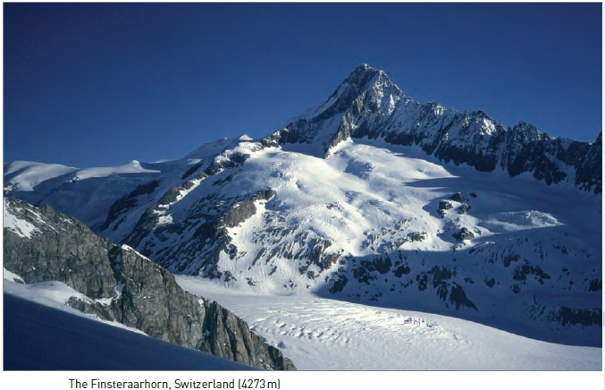
Finsteraarhorn, Switzerland (4273m)

Slide 52
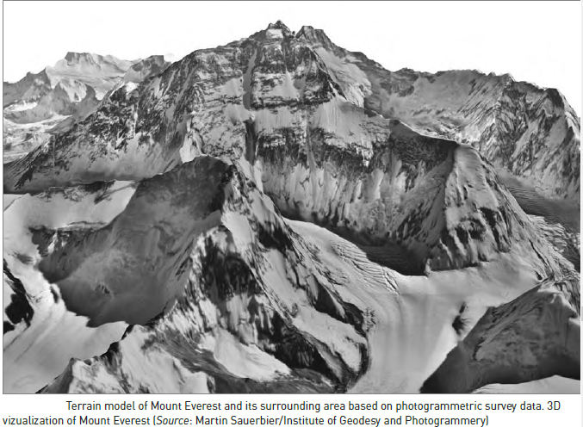
Terrain model of Mount Everest (8849 m)

Slide 53
Errors arising from our understanding and modelling of reality
The summit of Mount Everest (8849 m) is part of a larger massif and is joined to Lhotse (8501 m).
From these two peaks are several ridges or arêtes that link satellite peaks including Nuptse (7861m) and Shartse II (7590 m).
All might be considered part of the bulk of Mount Everest, but could also be considered separate mountains in their own right, and this still leaves us with the problem of defining where Everest begins and ends.

Slide 54
Errors arising from our understanding and modelling of reality
The problem of identifying mountains.
Next we need to decide what feature type is best used to show the location of the mountain at the scale being used.
Is it a point with attributes of name and height?
Is it a series of nested contour lines and spot heights with height attributes?
Is it a polygon around the base of the mountain or series of polygons showing the individual morphological units that make up the mountain?

Slide 55
Errors arising from our understanding and modelling of reality
Is it a surface feature shown as a TIN or DEM? Or
Is it, as Fisher and Wood (1998) suggest, actually a fuzzy object whose extent is dependent on personal perception, scale and resolution?
Whatever GIS model we adopt, it is a simplification of this reality, and any simplification of reality will include errors of generalization, completeness and consistency.

Slide 56
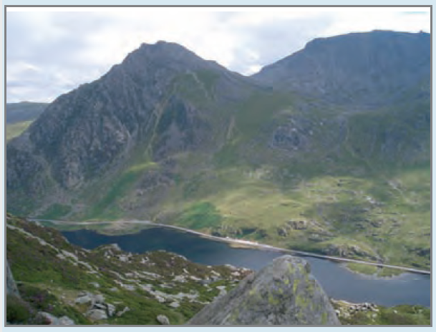
Visualize the problem for Tryfan; a mountain in north Wales.
Photograph of Tryfan

Slide 57
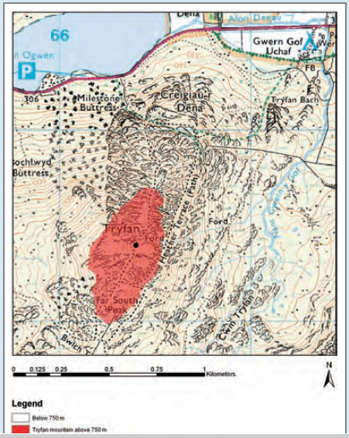
Ordnance Survey 1:50,000 topographic map showing area above 750m

Slide 58
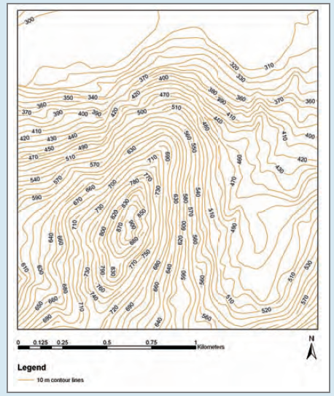
Contour map

Slide 59
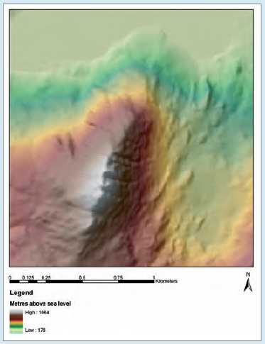
DEM Representation

Slide 60
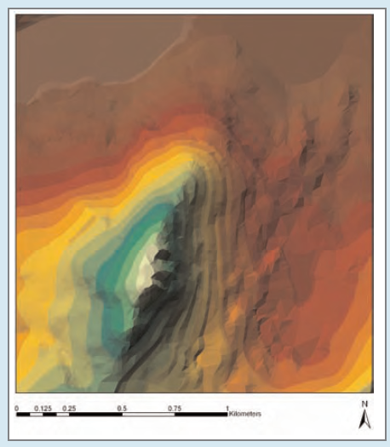
TIN Representation

Slide 61
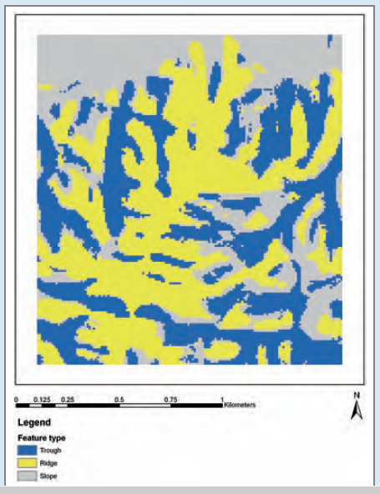
Topographic features

Slide 62
Errors in source data for GIS
Our models of reality in GIS are built from a variety of data sources including survey data, remotely sensed and map data.
All sources of spatial and attribute data for GIS are likely to include errors.
Three examples of data sources are examined below to identify possible errors.
Survey data can contain errors due to mistakes made by people operating equipment or recording observations, or due to technical problems with equipment.

Slide 63
Errors in source data for GIS
For example, if sites of damage to ski pistes were being recorded using a GPS, errors in spatial data might occur if there were technical problems with the receiver.
Errors in attribute data could occur if features were recorded incorrectly by the operator.
A visitor survey of holidaymakers in Happy Valley could include spatial errors if postal codes for the visitors’ home addresses were wrongly remembered or recorded. Attribute errors would occur if the characteristics of the respondents were wrongly allocated, or incorrectly noted.

Slide 64
Errors in source data for GIS
Remotely sensed and aerial photography data could have spatial errors if they were spatially referenced wrongly, and mistakes in classification and interpretation would create attribute errors.
For example, clouds on remotely sensed imagery commonly obscure features of interest on the ground.
Shadows from mountains, buildings, trees and other tall structures can lead to problems of misclassification and further obscure interesting detail.

Slide 65
Errors in source data for GIS
It should also be remembered that these data sources are ‘snapshots’ of reality, showing the location and nature of features at a particular moment in time.
Thus, for any changeable features the date of the image used is extremely important.
Remotely sensed imagery can be very useful as many earth observing satellite platforms provide regular repeat coverage of the same area making their data ideal for identifying change.

Slide 66
Errors in source data for GIS
Maps are probably the most frequently used sources of data for GIS.
Maps contain both relatively straightforward spatial and attribute errors, caused by human or equipment failings, and more subtle errors, introduced as a result of the cartographic techniques employed in the map-making process.
Generalization is one cartographic technique that may introduce errors.

Slide 67
Errors in source data for GIS
There are other cartographic difficulties, some of which affect other types of data as well as maps.
These include the representation of continuous data and features with indistinct (or fuzzy) boundaries.
Problems may also be introduced because of sampling and measurement difficulties.
Cartographic data sources error are:
  CONTINUOUS DATA
  FUZZY BOUNDARIES
  MAP SCALE
  MAP MEASUREMENTS

Slide 68
Errors in source data for GIS
CONTINUOUS DATA:
Continuous data require special cartographic representation.
For example, height is usually represented by contours on paper maps. Annotated lines indicate land of a particular height above a datum (usually sea level).
Limited additional information is provided by spot heights. Apart from this, no information is given about the height of the land between contours, except that it lies somewhere in the range denoted by the bounding contours. Since height varies continually over space, the vector-based contour and spot height model is always a compromise for the representation of height data.

Slide 69
Errors in source data for GIS
FUZZY BOUNDARIES
Where changes between entities are gradual in nature, such as between soil types, vegetation zones or rural and urban areas of settlement, indistinct boundaries exist.
These ‘fuzzy’ boundaries are difficult to represent cartographically. As a result, features are often made distinct by drawing sharp boundaries around entities.
This will ultimately lead to positional errors and attribute uncertainty in digital map data.

Slide 70
Errors in source data for GIS
MAP SCALE
Whether the ‘fuzziness’ of natural boundaries is important depends largely on the scale at which the data are mapped and viewed.
For instance, if a soil boundary is mapped at a large scale (for example 1:1250) then the representation of a fuzzy boundary can result in a significant amount of error.
However, if the boundary is mapped at a much smaller scale (such as 1:25,000) then the error resulting from the representation, although still there, is no longer so significant.

Slide 71
Errors in source data for GIS
MAP SCALE
The thickness of the line used to draw the boundary on the map at this scale may well account for much of the fuzziness between the soil types on the ground.

Slide 72
Errors in source data for GIS
MAP MEASUREMENTS
Measurements on maps and other data sources are rarely 100 per cent accurate.
Generalization aside, measurements such as contour heights, feature locations and distances have limited accuracy because of human and mechanical error.
Human measurement error can result from personal bias (for example, in the interpretation of aerial photographs), typographical errors, equipment reading errors and mistakes in the use of equipment.
Examples of machine error may include limitations of surveying equipment, limited accuracy of GPS receivers and equipment calibration errors.

Slide 73
Errors in data encoding
Data encoding is the process by which data are transferred from some non-GIS source, such as the paper map, satellite image or survey, into a GIS format.
The method of data encoding, and the conditions under which it is carried out, are perhaps the greatest source of error in most GIS.
Digitizing, both manual and automatic, is an important method of data entry, so this section will focus on errors that can arise during digitizing.

Slide 74
Errors in data encoding
Despite the availability of hardware for automatic conversion of paper maps into digital form, much of the digitizing of paper maps is still done using a manual digitizing table.
Manual digitizing is recognized by researchers as one of the main sources of error in GIS (Otawa, 1987; Keefer et al., 1988; Dunn et al., 1990);
However, digitizing error is often largely ignored. Beyond simple checks in the editing process, practical means of handling digitizing errors do not exist in proprietary GIS software.

Slide 75
Errors in data encoding
Sources of error within the digitizing process are many, but may be broken down into two main types: source map error and operational error.
Operational errors are those introduced and propagated during the digitizing process.
Human operators can compound errors present in an original map (Poiker, 1982) and add their own distinctive error signature.
Some of the operational errors that can be introduced during manual digitizing are outlined.

Slide 76
Operational errors
Following the exact course of a line on a map with a digitizer cursor is a difficult task, requiring skill, patience and concentration.
Hand wobble, a tendency to under- or overshoot lines, strain and lack of hand–eye coordination are all sources of human error in the digitizing process.
Categorizes human digitizing error into two types:
  psychological and physiological.
To these can be added errors resulting from problems with line thickness and the method of digitizing which is used.

Slide 77
Operational errors
1 Psychological errors include difficulties in perceiving the true centre of the line being digitized and the inability to move the cursor cross-hairs accurately along it.
This type of error results in lateral offset between the true and digitized line and under- or overshoots at corners. Under- and overshoots and lateral displacement of features can be difficult to spot and correct.

Slide 78
Operational errors
2 Physiological errors result from involuntary muscle spasms (twitches and jerks) that give rise to random displacements or ‘spikes’ and polygonal knots or ‘switchbacks’ (Figure).
Some of these errors, such as spikes and knots, are easy to spot and correct.

Slide 79
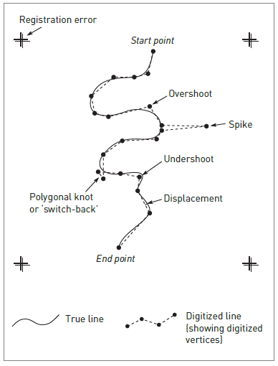
Operational errors

Slide 80
Operational errors
3 Line thickness. The thickness of lines on a map is determined by the cartographic generalization employed.
All lines are drawn so as to be visible to the user and thickness may in some instances reflect the perceived importance of the feature being depicted rather than its actual size on the ground.
A major road may be shown on a map by a line wider than the cross-hairs on the digitizer cursor.
Common sense suggests that the true course of the line is along its mid-point, but it is a difficult task for the operator to follow the centre of the line exactly.
Some displacement of the cursor either side of the centre line is inevitable, leading to positional errors in the resulting data.

Slide 81
Operational errors
4 Method of digitizing. There are two basic methods of manual digitizing: point mode and stream mode.
Point mode digitizing allows careful selection of sample points to create a faithful representation of a line.
This method involves a certain amount of generalization by the operator, who decides both the
number and location of sample points.
The greater the sample size, the greater the detail, but the positional error associated with each point remains much the same.

Slide 82
Operational errors
In stream mode digitizing, sampling is determined by the frequency set by the user at the start of the digitizing session.
The number of points sampled is controlled more by line complexity, since the operator can move relatively quickly along straight sections but needs to slow down significantly to navigate the cursor along more convoluted sections.

Slide 83
Operational errors
The errors occur during the digitizing process. However, errors can arise earlier.
For example, before starting to digitize, the map needs to be placed on the digitizing table and registered to enable later conversion from digitizer to
geographic co-ordinates.
If this is done incorrectly or carelessly then the whole set of co-ordinates digitized during that session will contain the same error or bias.
Care when setting up the map document on the digitizer is therefore essential.

Slide 84
Operational errors
Automatic digitizing, like manual digitizing, requires correct registration of the map document before digitizing commences, but there the similarity ends.
By far the most common method of automatic digitizing is the use of a raster scanner.
This input device suffers from the same problems regarding resolution as the raster data model.
Cell size is important. The smaller the cell size, the greater the resolution of the resulting image and the greater the quantity of the data produced.

Slide 85
Operational errors
Cell size is determined by the resolution of the machine being used; a fine resolution may produce data with less positional error than manual digitizer output.
Data input by either manual or automatic digitizing will almost always require editing and cleaning. This is the next source of errors in GIS.

Slide 86
Errors in data editing and conversion
After data encoding is complete, cleaning and editing are almost always required. These procedures are the last line of defence against errors before the data are used for analysis.
Of course, it is impossible to spot and remove all the errors, but many problems can be eliminated by careful scrutiny of the data.
As a potential source of error, cleaning and editing do not rank high; they are positive processes. Some GIS provide a suite of automated procedures, which can lead to unexpected results.

Slide 87
Errors in data editing and conversion
For example, it is common for vector GIS software to contain routines to check and build topology.
The closing of ‘open’ polygons and the removal of ‘dangling’ lines (over overshoots) are controlled by tolerances set by the user.
If the tolerances are set too low, then the gaps in polygons will not be closed and overshoots will not be removed. Alternatively, if the tolerances are set too high, small polygons may disappear altogether and large dangling lines, which may be required on networks, may also disappear (Figure).

Slide 88
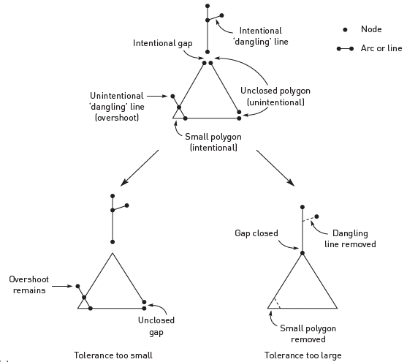
Topological errors in vector GIS
Effects of tolerances on topological cleaning

Slide 89
Errors in data editing and conversion
A different problem occurs when automated techniques are used to clean raster data. The main problem requiring attention is ‘noise’ – the misclassification of cells.
Noise can be easy to spot where it produces a regular pattern, such as striping.
At other times it may be more difficult to identify as it
occurs as randomly scattered cells.
These noise errors can be rectified by filtering the raster data to reclassify single cells or small groups of cells by matching them with general trends in the data.

Slide 90
Errors in data editing and conversion
The ‘noisy’ cells are given the same value as their neighbouring cells.
Filtering methods for this process are discussed. Choosing an appropriate method is important as the wrong method may remove genuine variation in the data or retain too much of the noise.
After cleaning and editing data it may be necessary to convert the data from vector to raster or vice versa. During vector to raster conversion both the size of the raster and the method of rasterization used have important implications for positional error and, in some cases, attribute uncertainty.

Slide 91
Errors in data editing and conversion
The smaller the cell size, the greater the precision of the resulting data. Finer raster sizes can trace the path of a line more precisely and therefore help to reduce classification error – a form of attribute error.
Positional and attribute errors as a result of generalization are seen as classification error in cells along the vector polygon boundary.
This is seen visually as the ‘stepped’ appearance of the raster version when compared with the vector original (Figure).

Slide 92
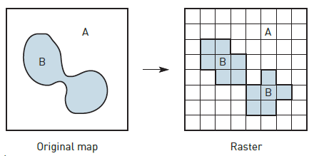
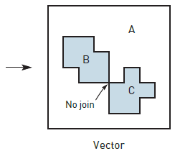
Topological ambiguities in raster to vector conversion

Slide 93
Errors in data editing and conversion
Provides further examples of errors created during the vector to raster conversion process. The results of this process are often more generalized data with more uncertainty attached.
The conversion of data from raster to vector format is largely a question of geometric conversion; however, certain topological ambiguities can occur – such as where differently coded raster cells join at corners as in Figure.

Slide 94
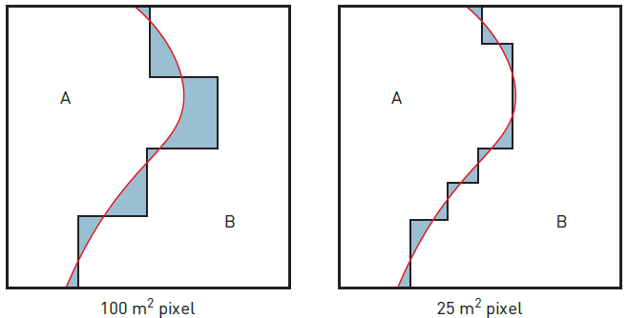
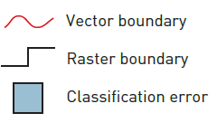
Vector to raster classification error

Slide 95
Errors in data editing and conversion
In this case it is impossible to say, without returning to the original source data, whether the vector polygons should join. Where vector maps have been derived from raster data, conversion may result in a stepped appearance on the output map.
This can be reduced, to some extent, by line-smoothing algorithms, but these make certain assumptions about topological relationships and detail that may not be present in the raster source data.

Slide 96
Rasterization errors
Vector to raster conversion can cause an interesting assortment of errors in the resulting data.
For example:
1 Topological errors. These include loss of connectivity, creation of false connectivity, loss of information, where individual vector polygons are smaller than the chosen raster cell size, and ambiguities due to changes in raster orientation and datum.
Connectivity problems occur when rasterizing vector polygons are separated by narrow gaps or connected via long narrow corridors. Significant features such as these are easily lost if they are narrower than an individual raster cell.

Slide 97
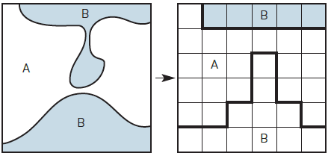
Loss of connectivity and creation of false connectivity

Slide 98
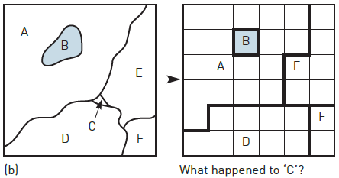
Loss of Information

Slide 99
Rasterization Errors
2 Loss of small polygons. When individual vector polygons are less than half the area of the raster cell or small enough to be missed by adjacent cell centroids, they may be lost in the conversion process.
3 Effects of grid orientation. If two identical grids are placed over the same vector map but at different angles (such that the difference between the angles is not a multiple of 90), the resulting raster maps will be different from each other.
It is usual when rasterizing vector data for the grid to be oriented parallel to the co-ordinate system of the source data.

Slide 100
Rasterization Errors
However, certain circumstances may dictate that a different orientation is required (such as when integrating rasterized vector data with satellite imagery where the satellite track is not parallel to the vector co-ordinate system or when using data digitized on a different projection system). This is illustrated in Figure.
4 Variations in grid origin and datum. Using the same grid but with slightly different origins (where the difference is not a multiple of raster size) will result in two different raster maps in much the same fashion as with grid orientation. This is illustrated in Figure.

Slide 101
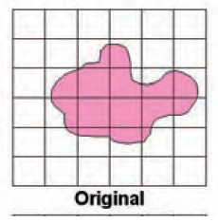
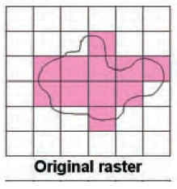
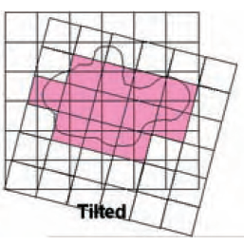
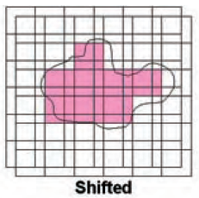
Effect of grid orientation
Effect of grid orientation and origin on rasterization

Slide 102
Rasterization Errors
Most GIS packages provide data conversion software so that their files can be read by other GIS.
For example, a GIS program may not be able to read data from a CAD package, so a conversion program is supplied to convert to another format, such as DXF, which both can handle.
Users naturally assume that these conversion routines work without introducing new errors into the data. However, the transfer of a GIS database from one software package to another can lead to errors through changes in format and definitions.
These database transfer errors are a kind of ‘mechanical’ error that is often overlooked. To overcome this problem standard formats have been developed such as those being promoted by the OpenGIS Consortium.

Slide 103
Errors in data processing and analysis
Errors may be introduced during the manipulation and analysis of the GIS database. GIS users must ask themselves questions before initiating a GIS analysis.
For example: Are the data suitable for this analysis? Are they in a suitable format? Are the data sets compatible?
Are the data relevant? Will the output mean anything? Is the proposed technique appropriate to the desired output?
These questions may seem obvious but there are many examples of inappropriate analysis.

Slide 104
Errors in data processing and analysis
These include the inappropriate phrasing of spatial queries, overlaying maps which have different co-ordinate systems, combining maps which have attributes measured in incompatible units, using maps together that have been derived from source data of widely different map scales and using an exact and abrupt method of interpolation (such as Thiessen polygons) to interpolate approximate and gradual point data (height data collected using GPS).
GIS operations that can introduce errors include the classification of data, aggregation or disaggregation of area data and the integration of data using overlay techniques.

Slide 105
Errors in data processing and analysis
The way in which we classify and reclassify data affects what we see and therefore how we interpret the data.
Choropleth mapping is an example. Much has been written in the cartographic literature on how the definition of class intervals in this sort of map can radically affect the pattern produced (Monmonier, 1996).
Take, for example, a choropleth map of unemployment by region drawn from census data. How the class intervals are defined can affect perception of unemployment across the country.

Slide 106
Errors in data processing and analysis
Similarly, how the areas are shaded also influences what we see in terms of pattern and magnitude. Dark colours in this instance can be used for the top two classes to create a more depressing feel.
Classification errors also affect raster data.
Classified satellite images provide a reflectance value for each pixel within a specific wavelength range or spectral band (for example, red, near infrared or microwave).
Raster maps of environmental variables, such as surface cover type, are derived by classifying each pixel in the image according to typical reflectance values for the range of individual cover types present in the image.

Slide 107
Errors in data processing and analysis
Error can occur where different land cover types have similar reflectance values (for example, asphalt car parks may have similar reflectance to mature spruce forest) and where shadows cast by terrain, trees or buildings reduce the reflectance value of the surface.
Careful choice of classification method can help to reduce this type of error.
Where a certain level of spatial resolution or a certain set of polygon boundaries are required, data sets that are not mapped with these may need to be aggregated or disaggregated to the required level.
This is not a problem if the data need to be aggregated from smaller areas into larger areas, provided that the smaller areas nest hierarchically into the larger areas.

Slide 108
Errors in data processing and analysis
Problems with error do occur, however, if we wish to disaggregate our data into smaller areas or aggregate into larger non-hierarchical units.
The information required to decide how the attribute data associated with the available units aggregates into the larger but non-nested units or disaggregates into a set of smaller units, rarely exists.
This problem is normally approached by assuming that the data in the source units are evenly distributed by area (for example, population within an enumeration district is evenly distributed across its total area).

Slide 109
Errors in data processing and analysis
The data for the new set of units or areas are in this case simply calculated as a function of the area of overlap with the source units.
However, such a homogeneous distribution of data within the source units cannot always be correctly assumed. In the case of population, distribution will depend on urban morphology, which can vary over small areas.
For example, even population distribution may be assumed across an area of similar housing type, but in an area of mixed land use (for example, housing, parkland and industrial estates) it cannot.
Aggregation, disaggregation and classification errors are all combined in the modifiable areal unit problem (MAUP).

Slide 110
Errors in data processing and analysis
Error arising from map overlay in GIS is a major concern and has correspondingly received much attention in the GIS literature (Chrisman, 1989; Goodchild and Gopal, 1989; Openshaw, 1989).
This is primarily because much of the analysis performed using GIS consists of the overlay of categorical maps (where the data are presented in a a series of categories).
GIS allows the quantitative treatment of these data (for example, surface interpolation or spatial autocorrelation), which may be inappropriate.
Map overlay in GIS uses positional information to construct new zones from input map layers using Boolean logic or cartographic modelling.

Slide 111
Errors in data processing and analysis
Consequently, positional and attribute errors present in the input map layers will be transferred to the output map, together with additional error introduced by multiplicatory effects and other internal sources.
Data output from a map overlay procedure are only as good as the worst data input to the process.
Perhaps the most visual effect of positional error in vector map overlay is the generation of sliver polygons. Slivers (or ‘weird’ polygons) occur when two maps containing common boundaries are overlaid.

Slide 112
Errors in data processing and analysis
If the common boundaries in the two separate maps have been digitized separately, the co-ordinates defining the boundaries may be slightly different as a result of digitizing error. When the maps are overlaid a series of small, thin polygons will be formed where the common boundaries overlap (Figure).
Slivers may also be produced when maps from two different scales are overlaid.
Of course, sliver polygons can and do occur by chance, but genuine sliver polygons are relatively easy to spot by their location along common boundaries and their physical arrangement as long thin polygonal chains.

Slide 113
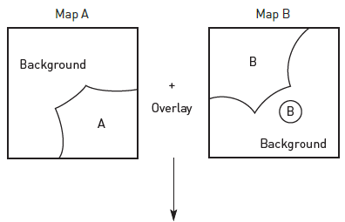
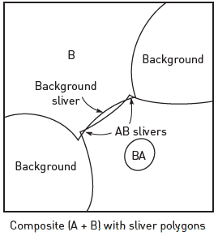
Generation of sliver polygons

Slide 114
Errors in data processing and analysis
Also shown in Figure is the attribute error that can result from positional error. If one of the two maps that are overlaid contains an error (such as the missing ‘hole’ feature in map A that is present as an island in map B), then a classification error will result in the composite map (polygon BA).
Chrisman (1989) identifies these two cases as extremes and points out that one type of error (positional or attribute) will inevitably result in the other type of error in the output map and vice versa.
Classification errors occur along the common boundary where the slivers are produced as a result of positional error and attribute error.

Slide 115
Errors in data output
From the preceding discussion it should be clear that all GIS databases will contain error. In addition, further errors will be introduced during manipulation and analysis of the data.
Therefore, it is inevitable that all GIS output, whether in the form of a paper map or a digital database, will contain inaccuracies. The extent of these inaccuracies will depend on the care and attention paid during the construction, manipulation and analysis of the databases.
It is also possible that errors can be introduced when preparing GIS output. For example, if we choose the map as a means of communicating the results of our analysis, it may be necessary to generalize data for the sake of clarity. This will add errors and assumptions into the database.

Slide 116
FINDING AND MODELLING ERRORS IN GIS
Much research effort has focused on identifying, tracking and reducing error in GIS. One American GIS research organization, the National Center for Geographic Information and Analysis, even placed the problem of error in GIS first on its list of research priorities (NCGIA, 1989).
Despite this research effort, little has been done to incorporate error identification, modelling and handling techniques within proprietary GIS packages.
This has had the effect of keeping awareness of the general error problem at a low level amongst non-specialist GIS users.
However, there are methods for detecting and modelling errors that users can employ to improve confidence in their data and results.
Methods for checking data include visual inspection, double digitizing, the examination of error signatures and statistical analysis.

Slide 117
Checking for errors
Probably the simplest means of checking for data errors is by visual inspection. This should be included as a matter of course in the data cleaning and editing process.
Once in a GIS format, data can be plotted on paper or on the graphics screen for visual comparison with the original source document.
Obvious oversights in the digitizing process and missing data will be revealed and can be amended. The attributes of spatial features can be checked by adding annotations, line colours and patterns.
Again, comparison with the original map should reveal major errors.

Slide 118
Checking for errors
Double digitizing is an error-checking method used by large digitizing operations (for example map producers such as the UK Ordnance Survey).
The same map is digitized twice (possibly by different people) and the resulting copies compared to identify inconsistencies.
Polygon areas, length of lines, polygon perimeters and the number of sliver polygons produced are calculated and compared.
If the two versions are deemed significantly dissimilar, then the map may be re-digitized and the comparison repeated. However, this is a costly and time-consuming method of error checking.

Slide 119
Checking for errors
Work on the psychological and physiological aspects of digitizing (Box 10.5) suggests that each operator has a different error signature that describes how they digitize.
An operator may, for example, consistently over- or undershoot changes in line direction or show lateral displacement relative to position on the digitizing table.
If different digitizer operators do have recognizable and repeatable error signatures, these could be used to effectively cancel out the errors introduced in digitizing.

Slide 120
Checking for errors
Various statistical methods can be employed to help pinpoint potential errors.
Attribute errors in GIS data sets may stand out as extreme data points in the distribution of data values; or outliers in scatter plots if plotted against a correlated variable (for example, total annual rainfall against number of rain days).
A statistical measure of the error attributed to generalization and line thickness can be gained by estimating the total area of the map covered by lines.
An example given by Burrough (1986) shows that a 1:25,000 scale soil map measuring 400 × 600 mm may have as much as 24,000 mm of drawn lines, covering 10 per cent of the map’s total area.

